Slide 1
Real-time Rendering of 3D Fractal Geometry
Dissertation Online Presentation
Solomon Baarda

Slide 2
Project Recap
Challenging and interesting topic
Real world value and application
Aims and objectives
Flexible scope with stretch goals
Requirements analysis
Risk analysis
Project plan and timeline

Slide 3

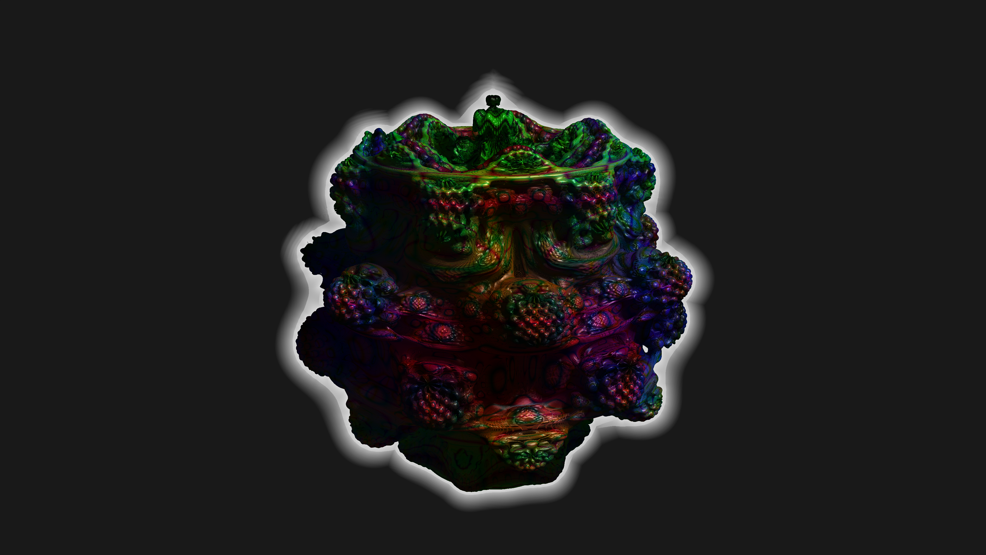
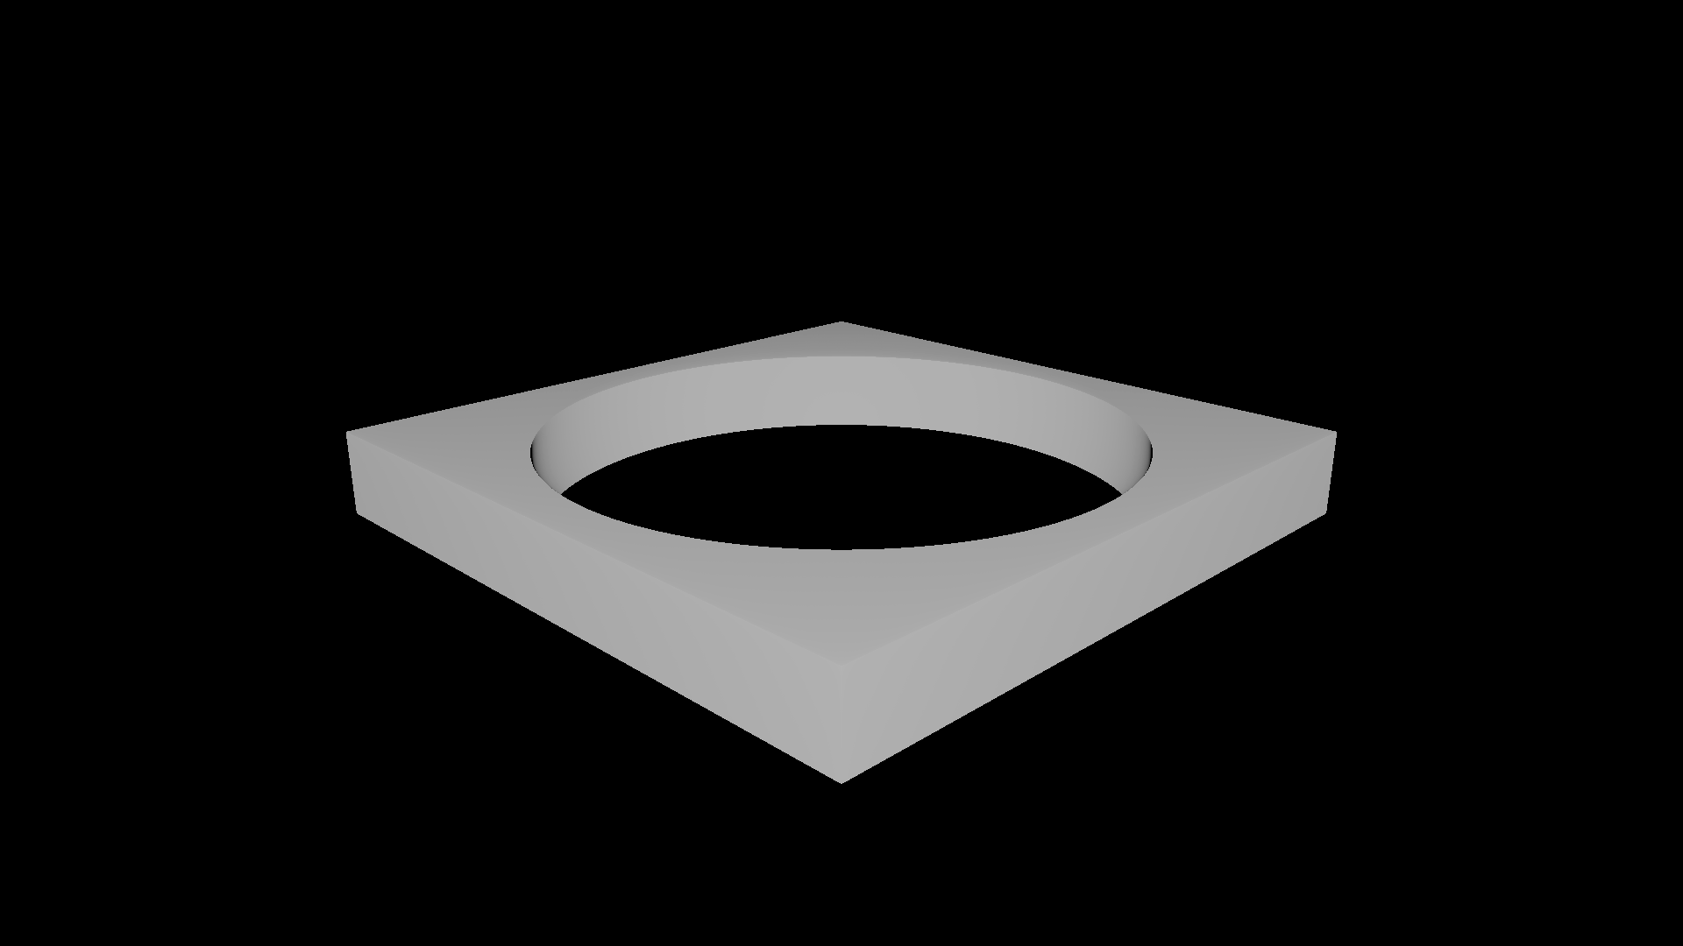
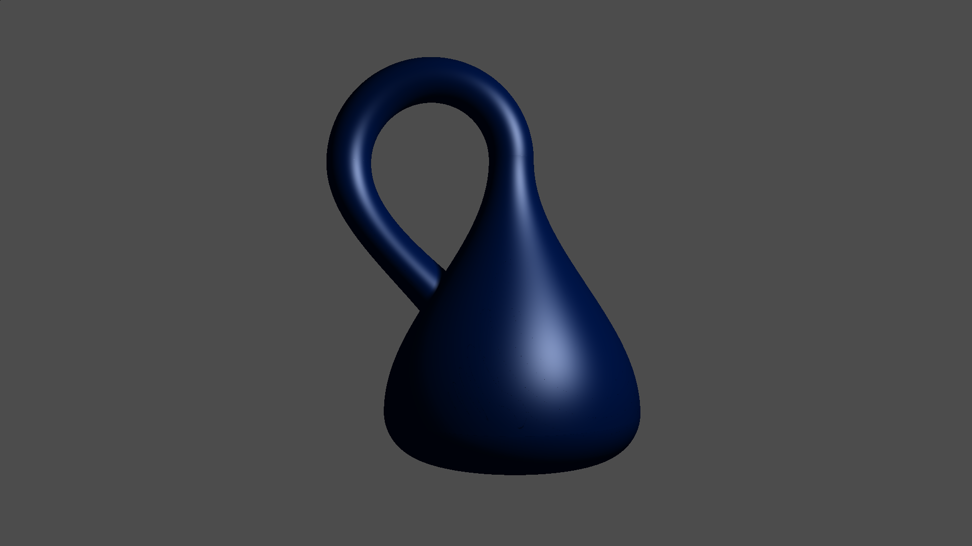
Work Completed
Created a real-time rendering engine for signed distance functions (SDFs)
This enables rendering of 3D fractals, Constructive Solid Geometry (CSG-models), and algebraic/meta-surfaces

Slide 4
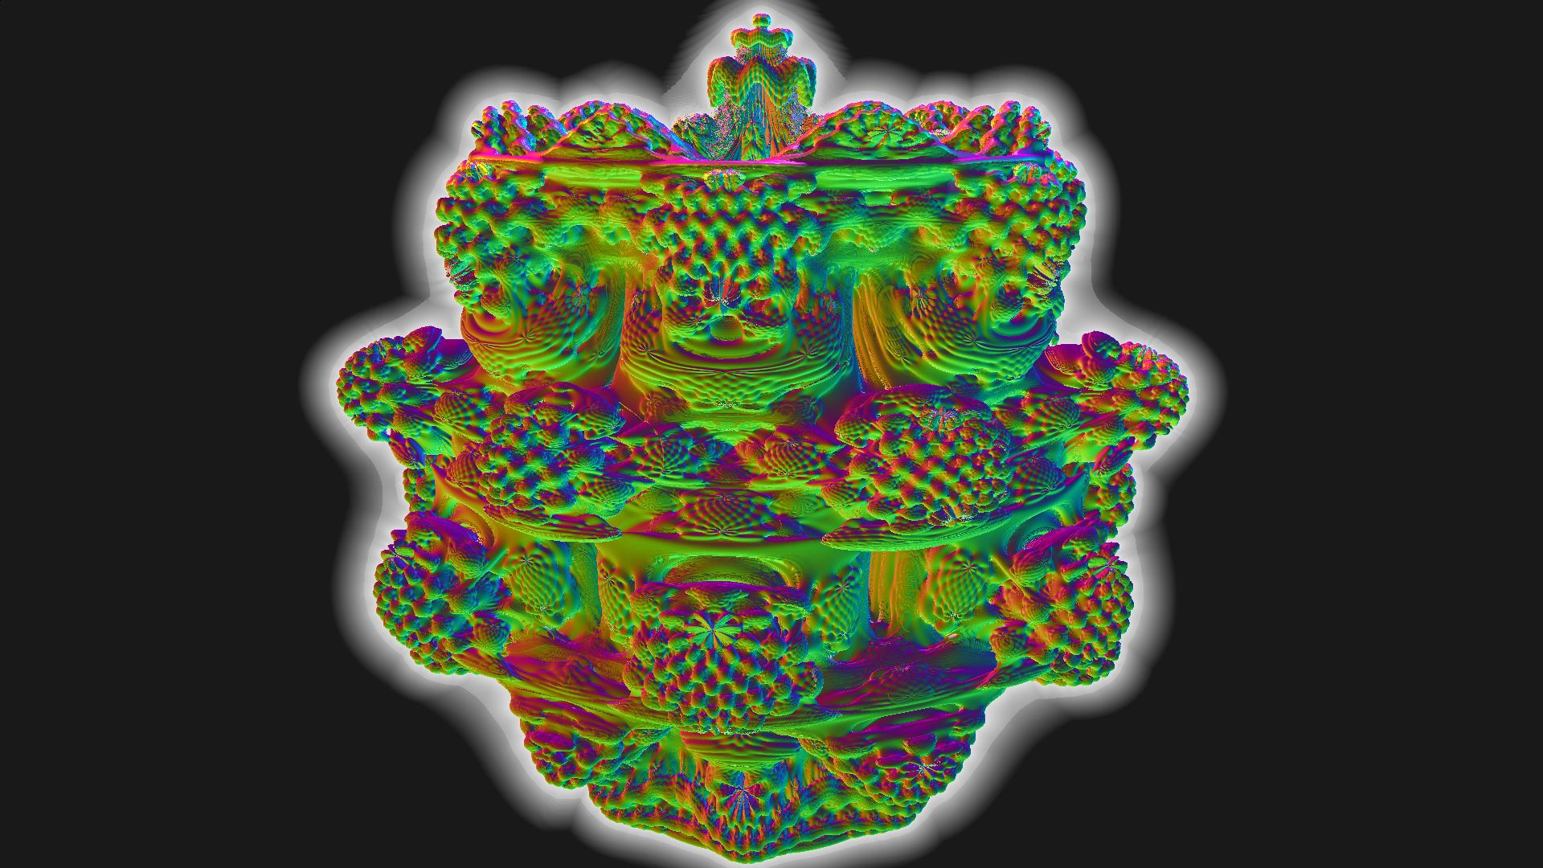
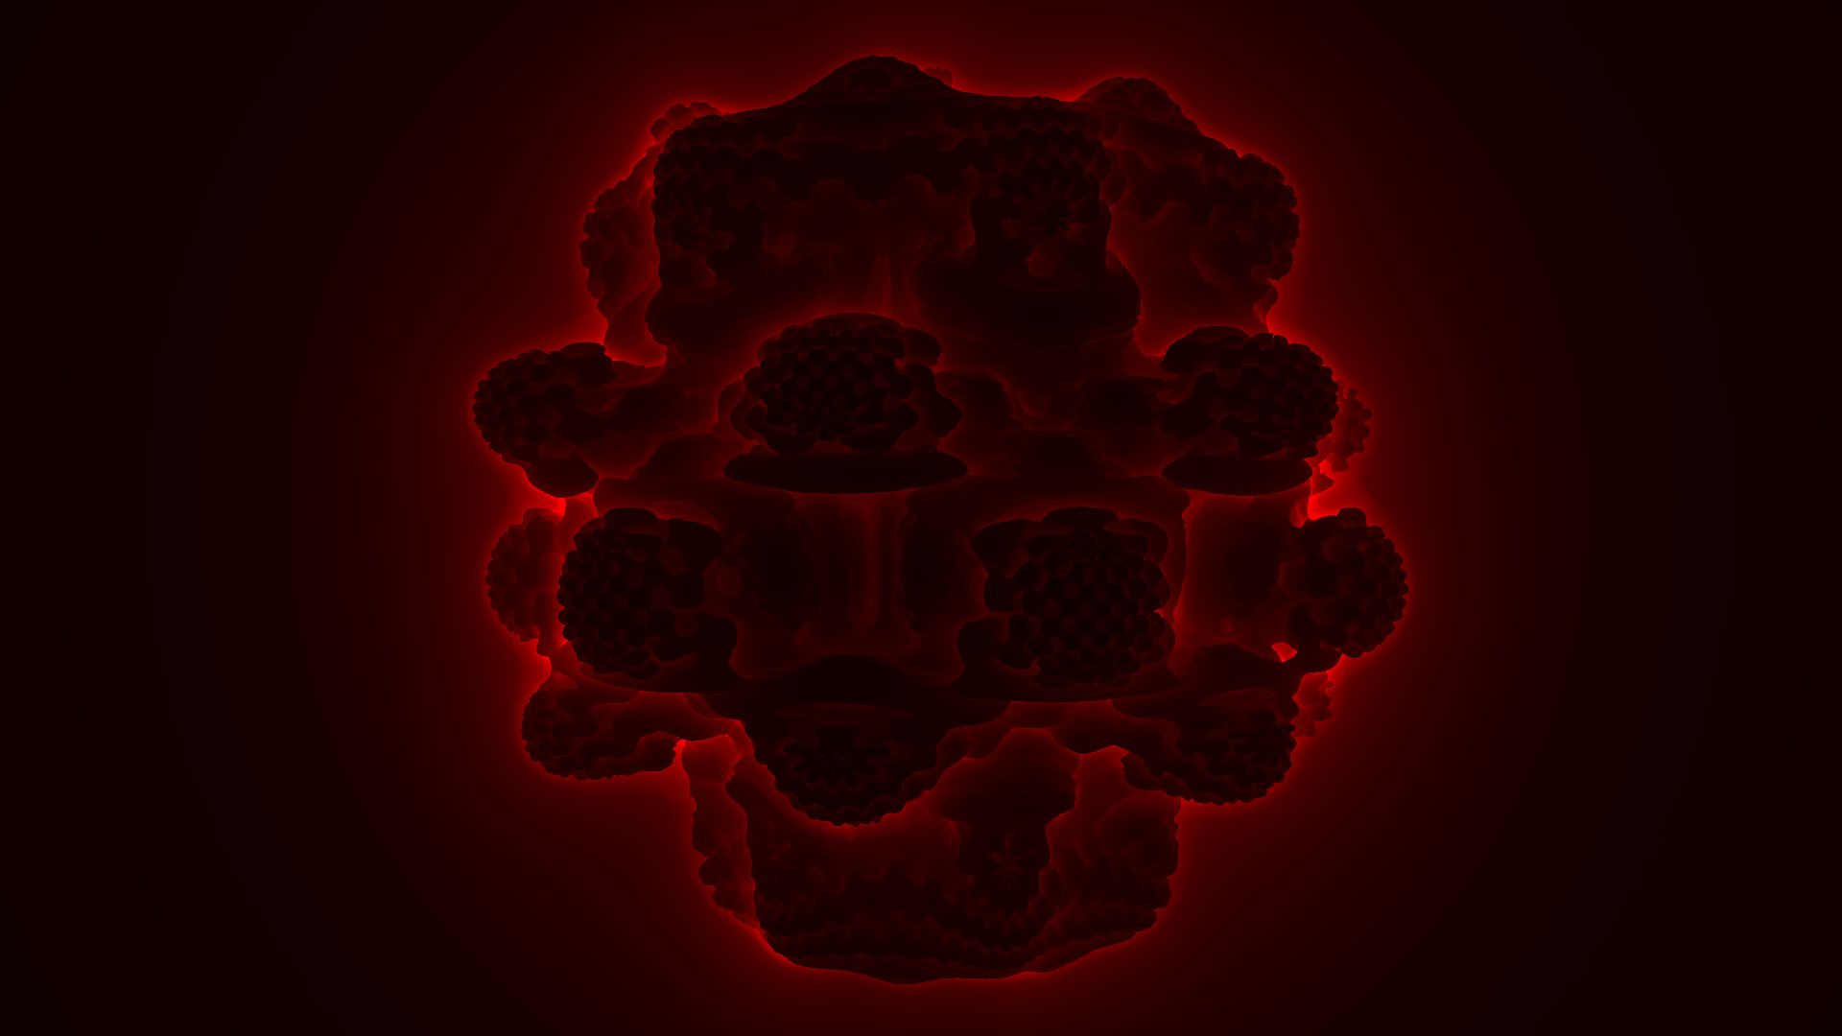

Additional Work Completed
Updated image gallery
Added debugging tools section to documentation
Added Klein bottle scene

Slide 5
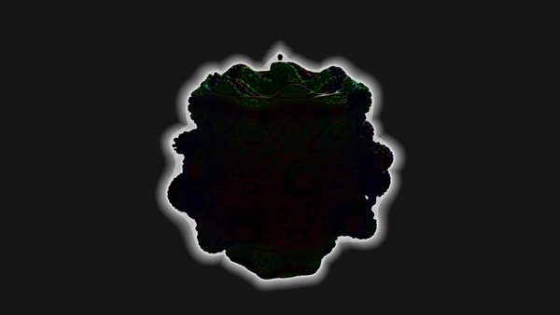
Application Evaluation
Performance benchmarking for optimisations and visual features
Unit tests for application code correctness
Performance benchmarking for scalability over different systems

Slide 6
Project Evaluation
Achieved/not achieved status for implementation of requirements
Goal based evaluation strategy for aims and objectives
Comparison with existing literature

Slide 7
Future Work
Licensed using the General Public License 3.0
GitHub repository for version control
developer and user documentation
Image gallery containing screenshots and videos of the application

Slide 8
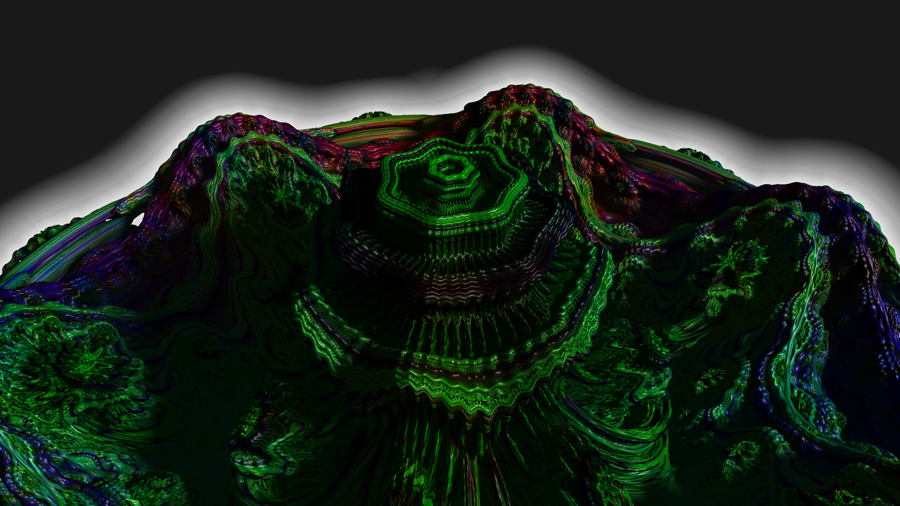
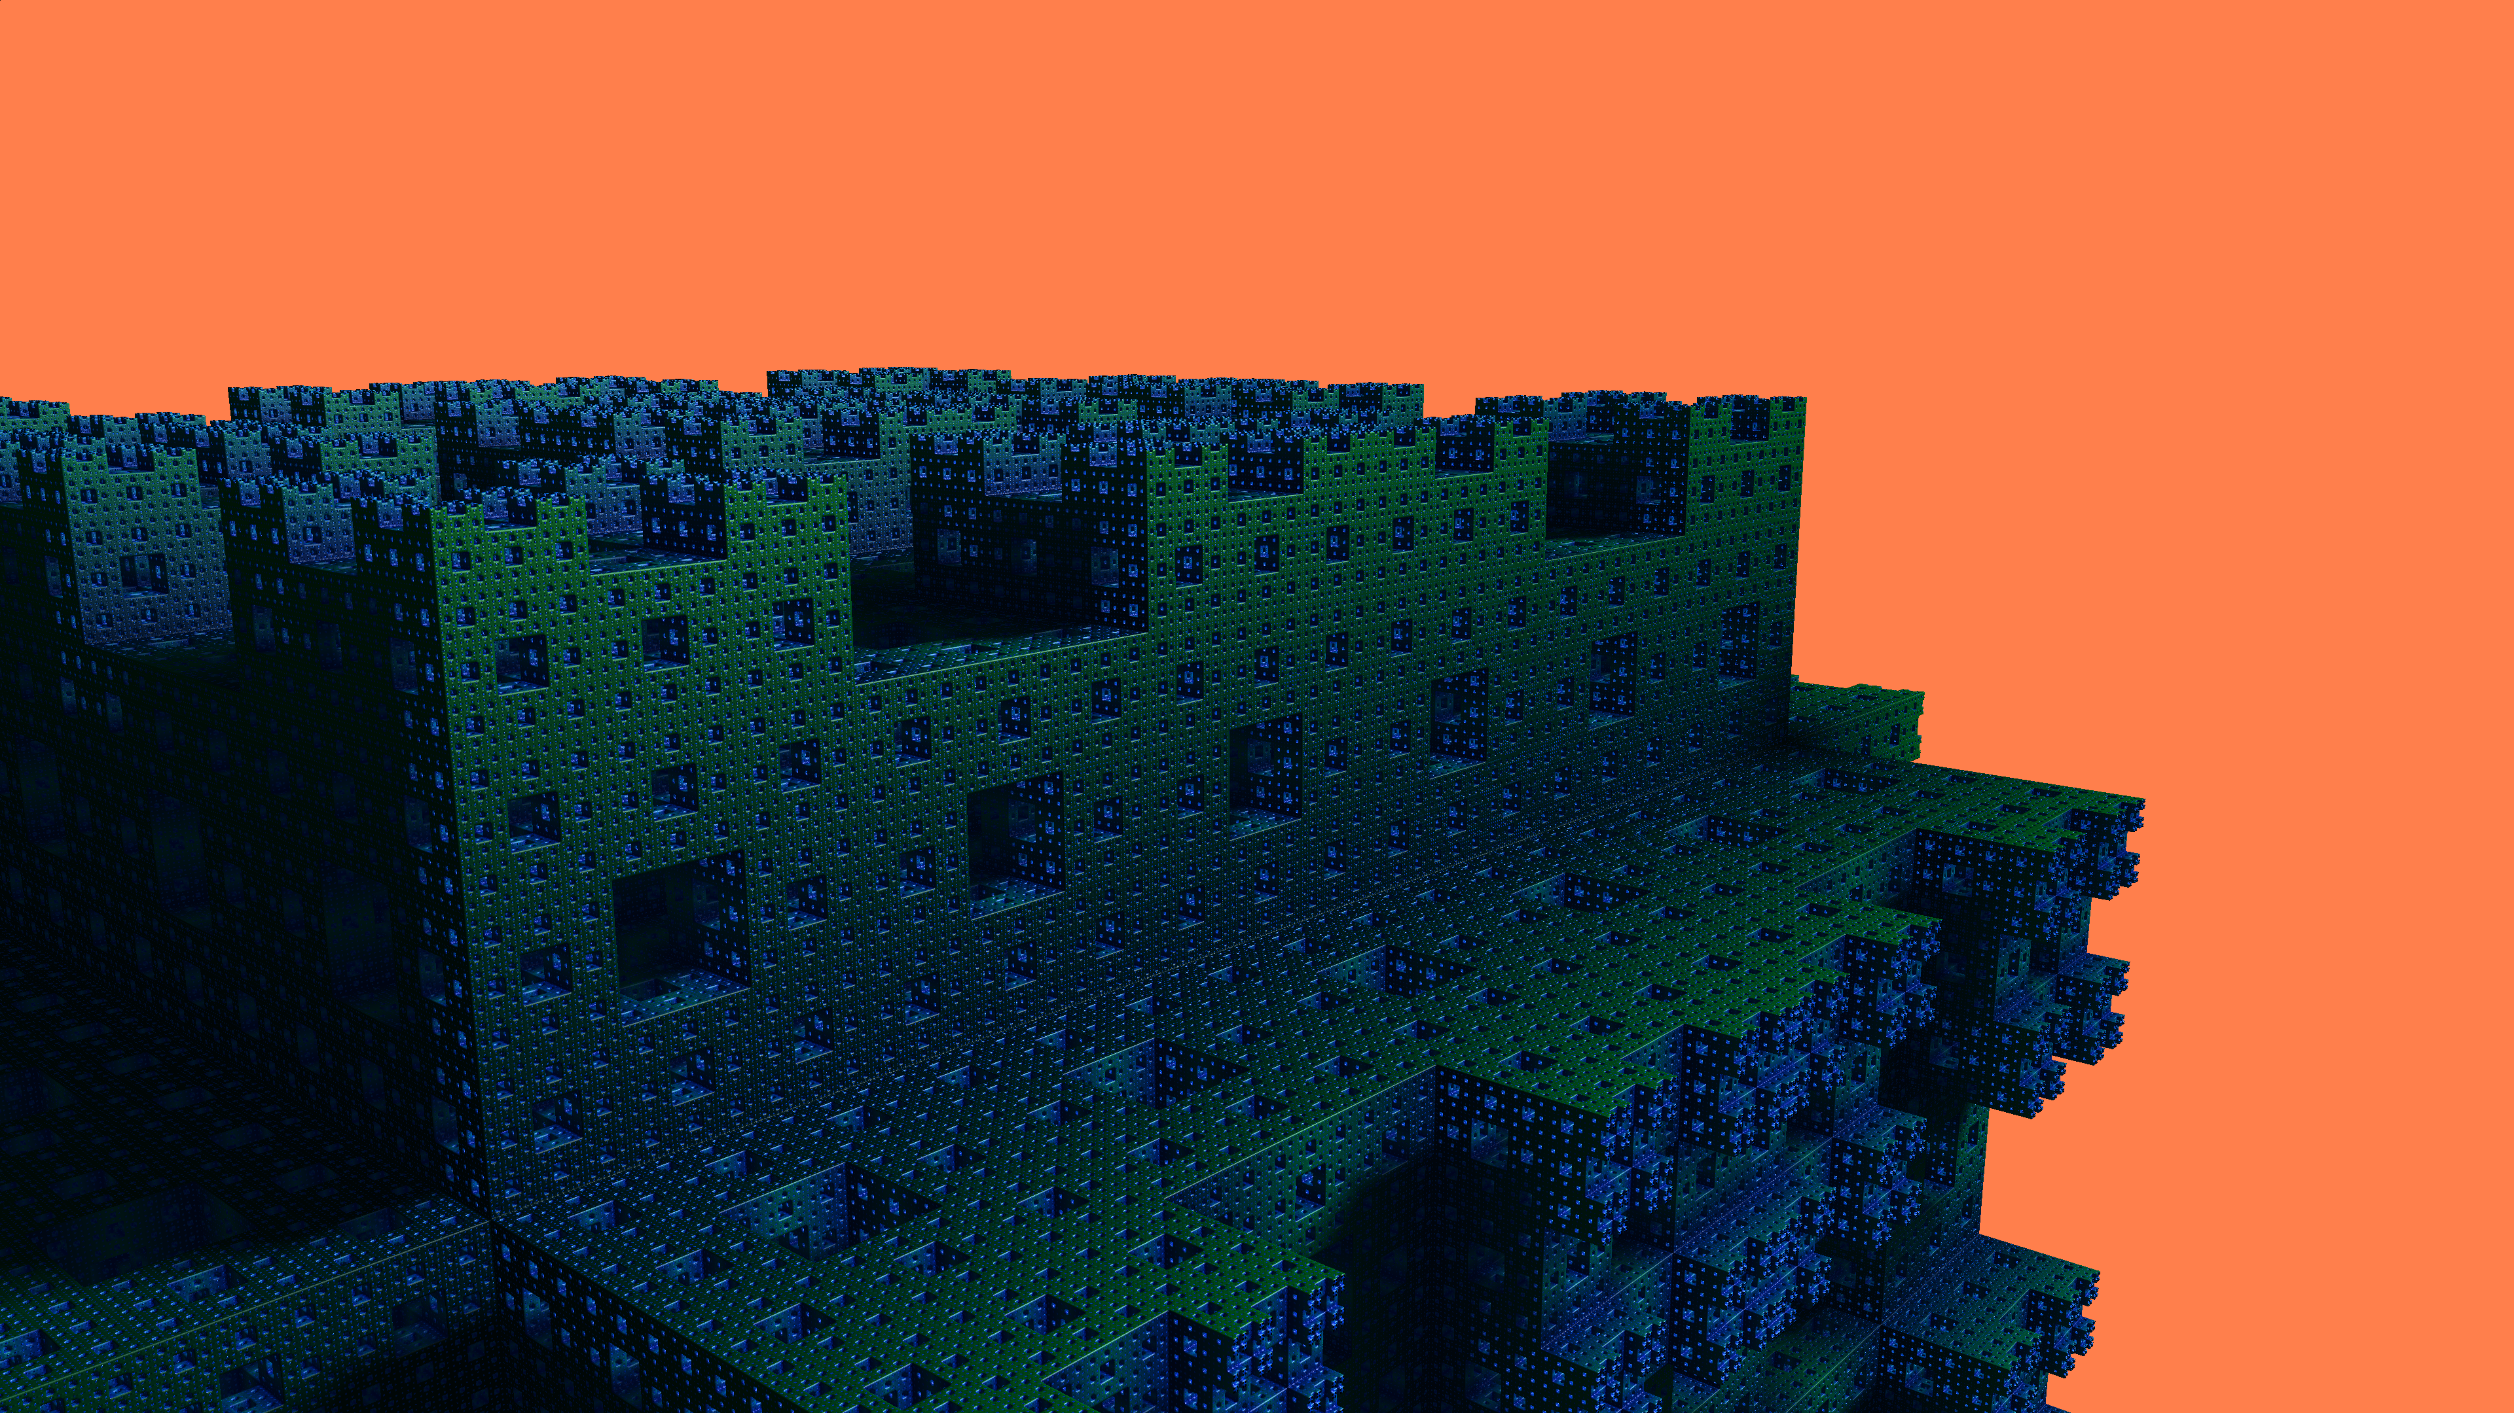
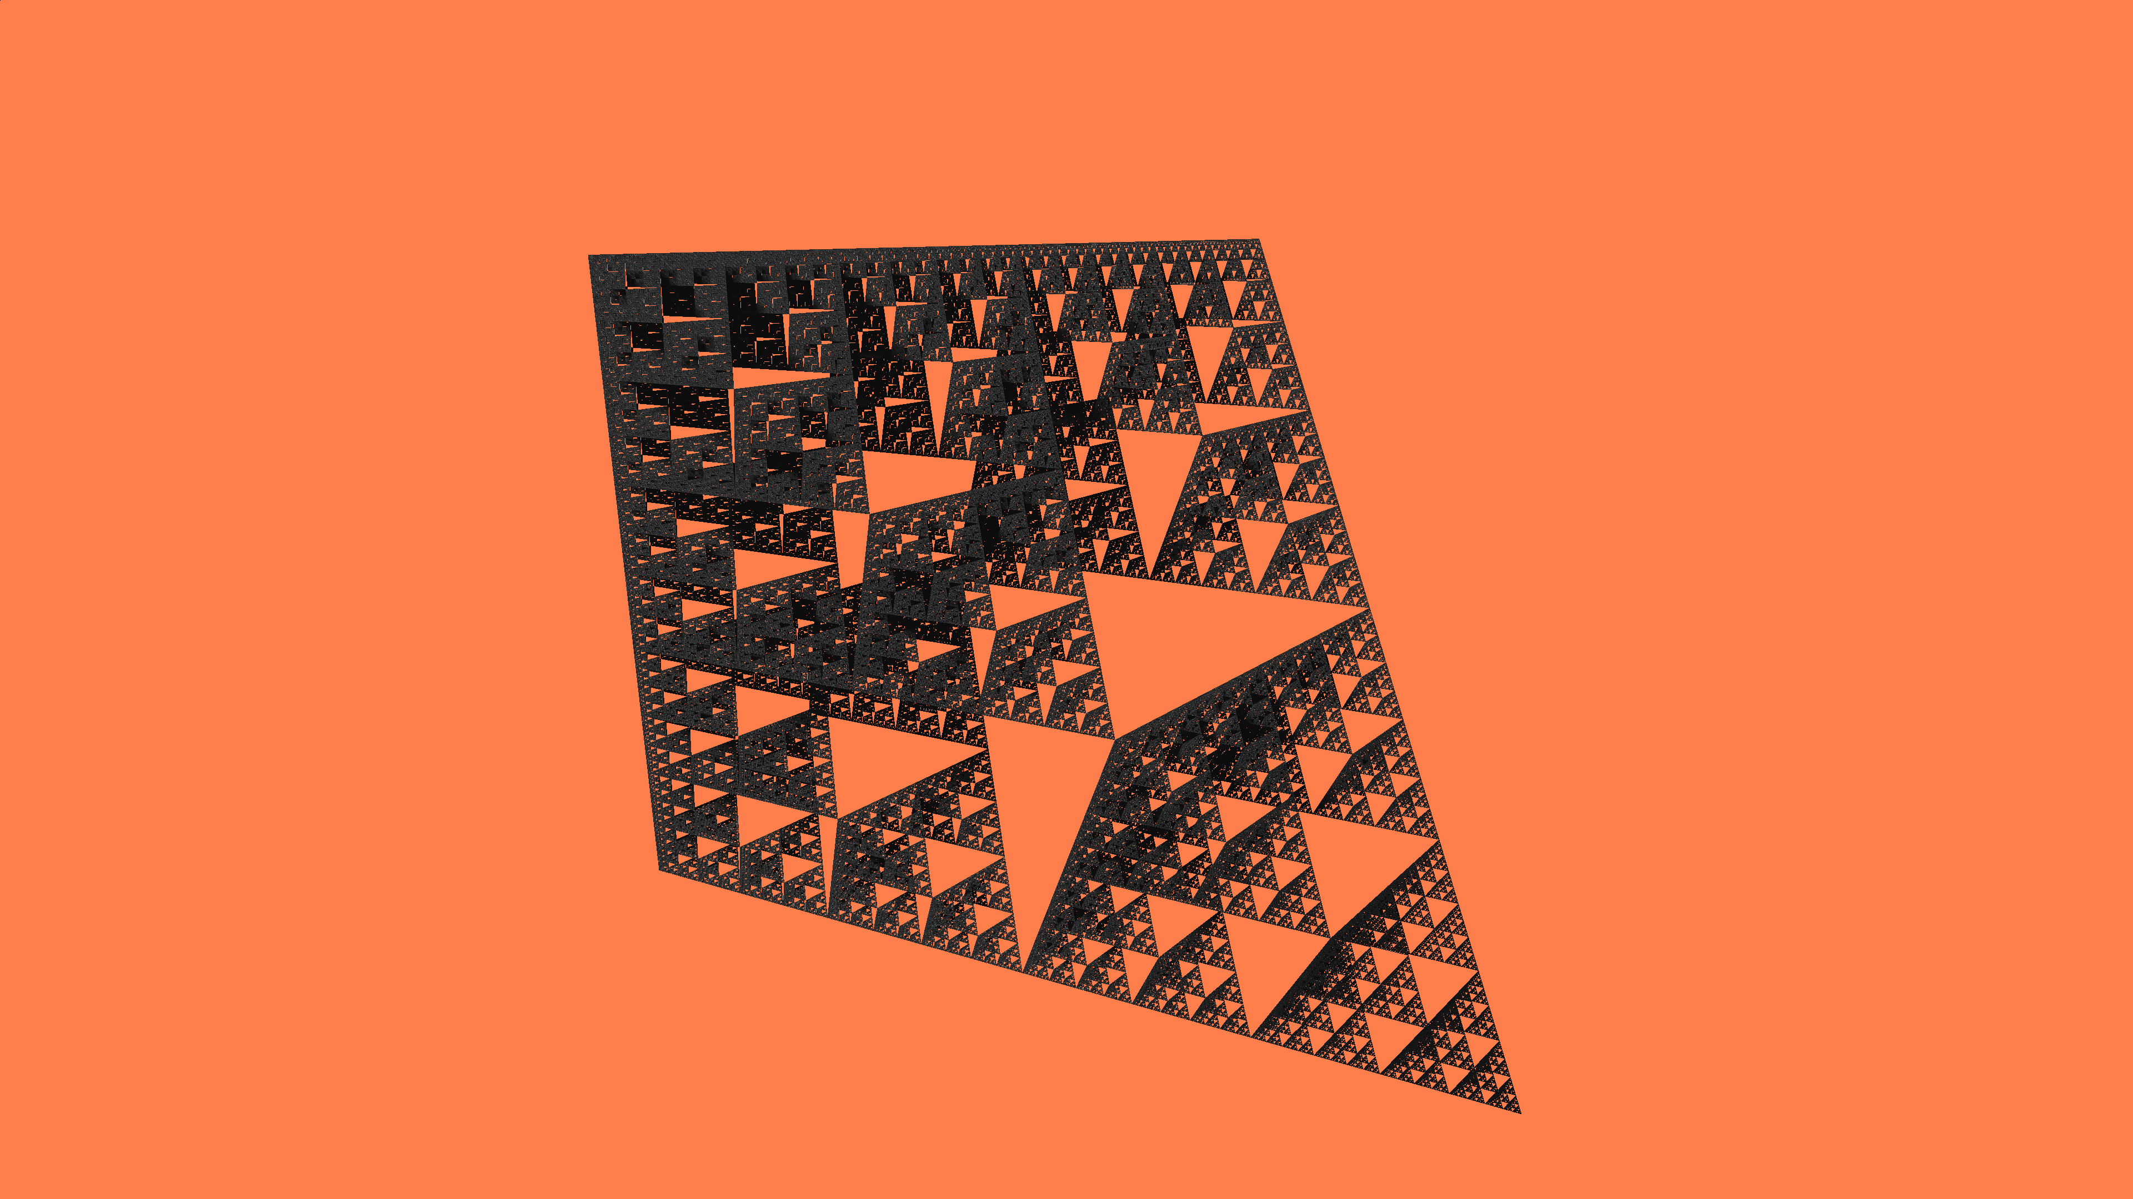

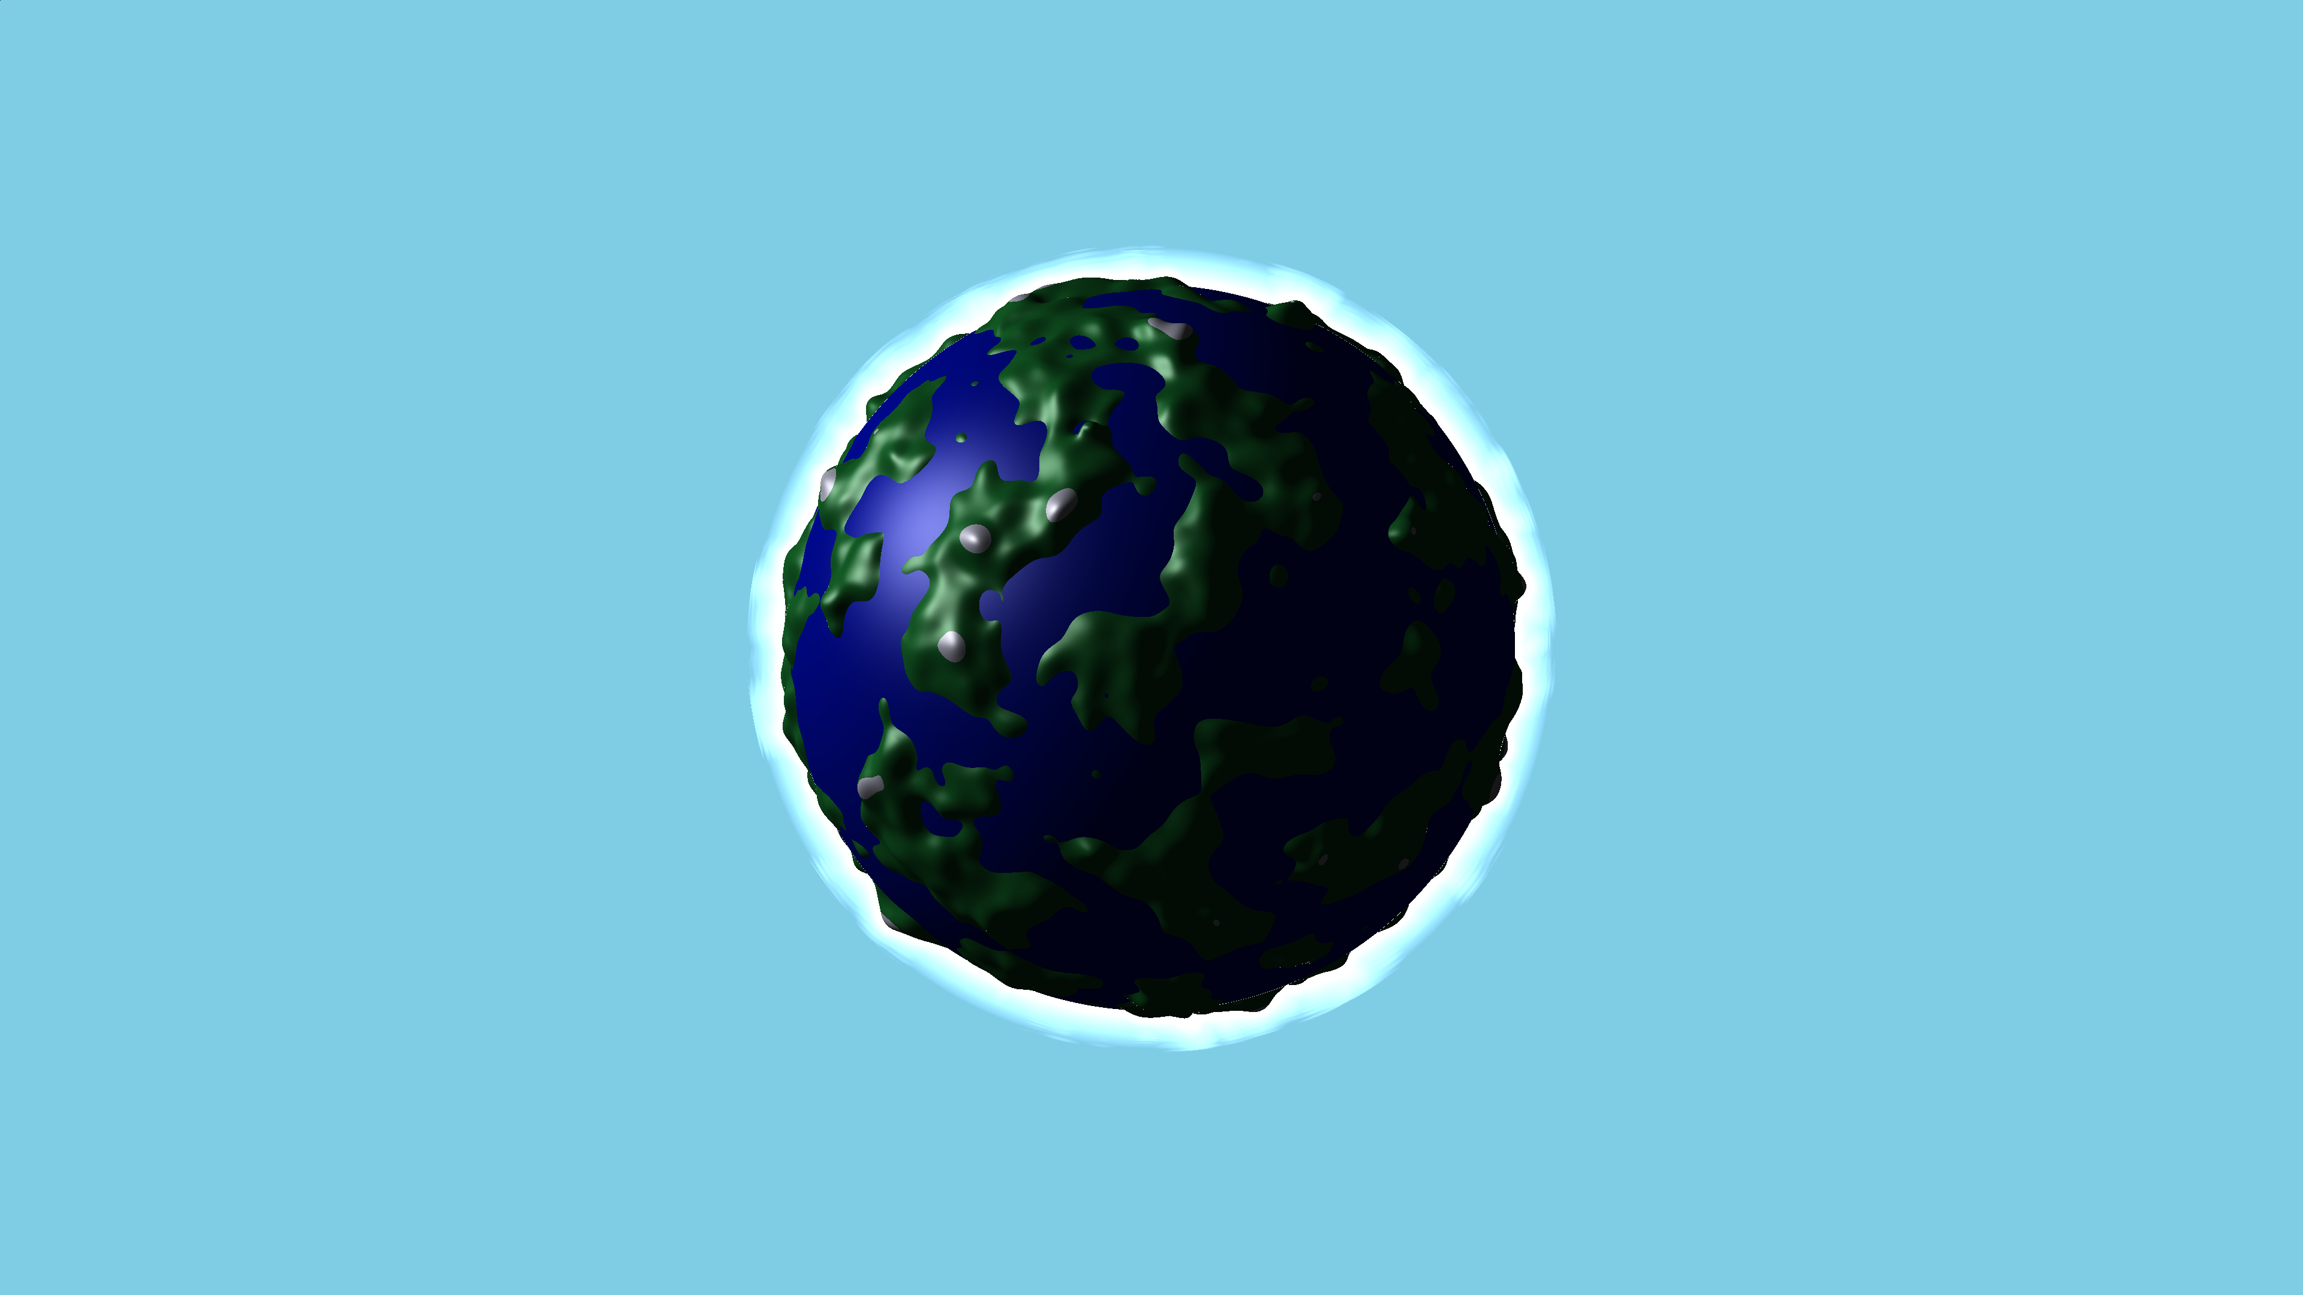
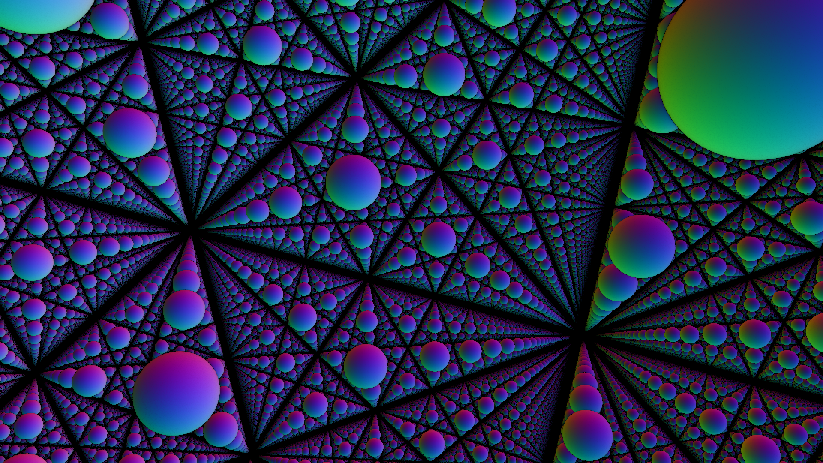
Thank you for your attention Any questions?

